Slide 1
CONTENT WRITING & COMMUNICATION COUNCIL
WOMEN´S INDIAN CHAMBER OF COMMERCE AND INDUSTRY
www.wicci.in

Slide 2
Council Vision &Mission
We the members of the Content Writing and communication council strive to empower ourselves and others with unity, communicate effectively to ignite minds and step forward to form liason with the government and other freelance agencies as to inspire meaningful content.

Slide 3
Welcoming
Council Members to
WICCI
President, Vice President
and 20+ Nominated Council Members

Slide 4
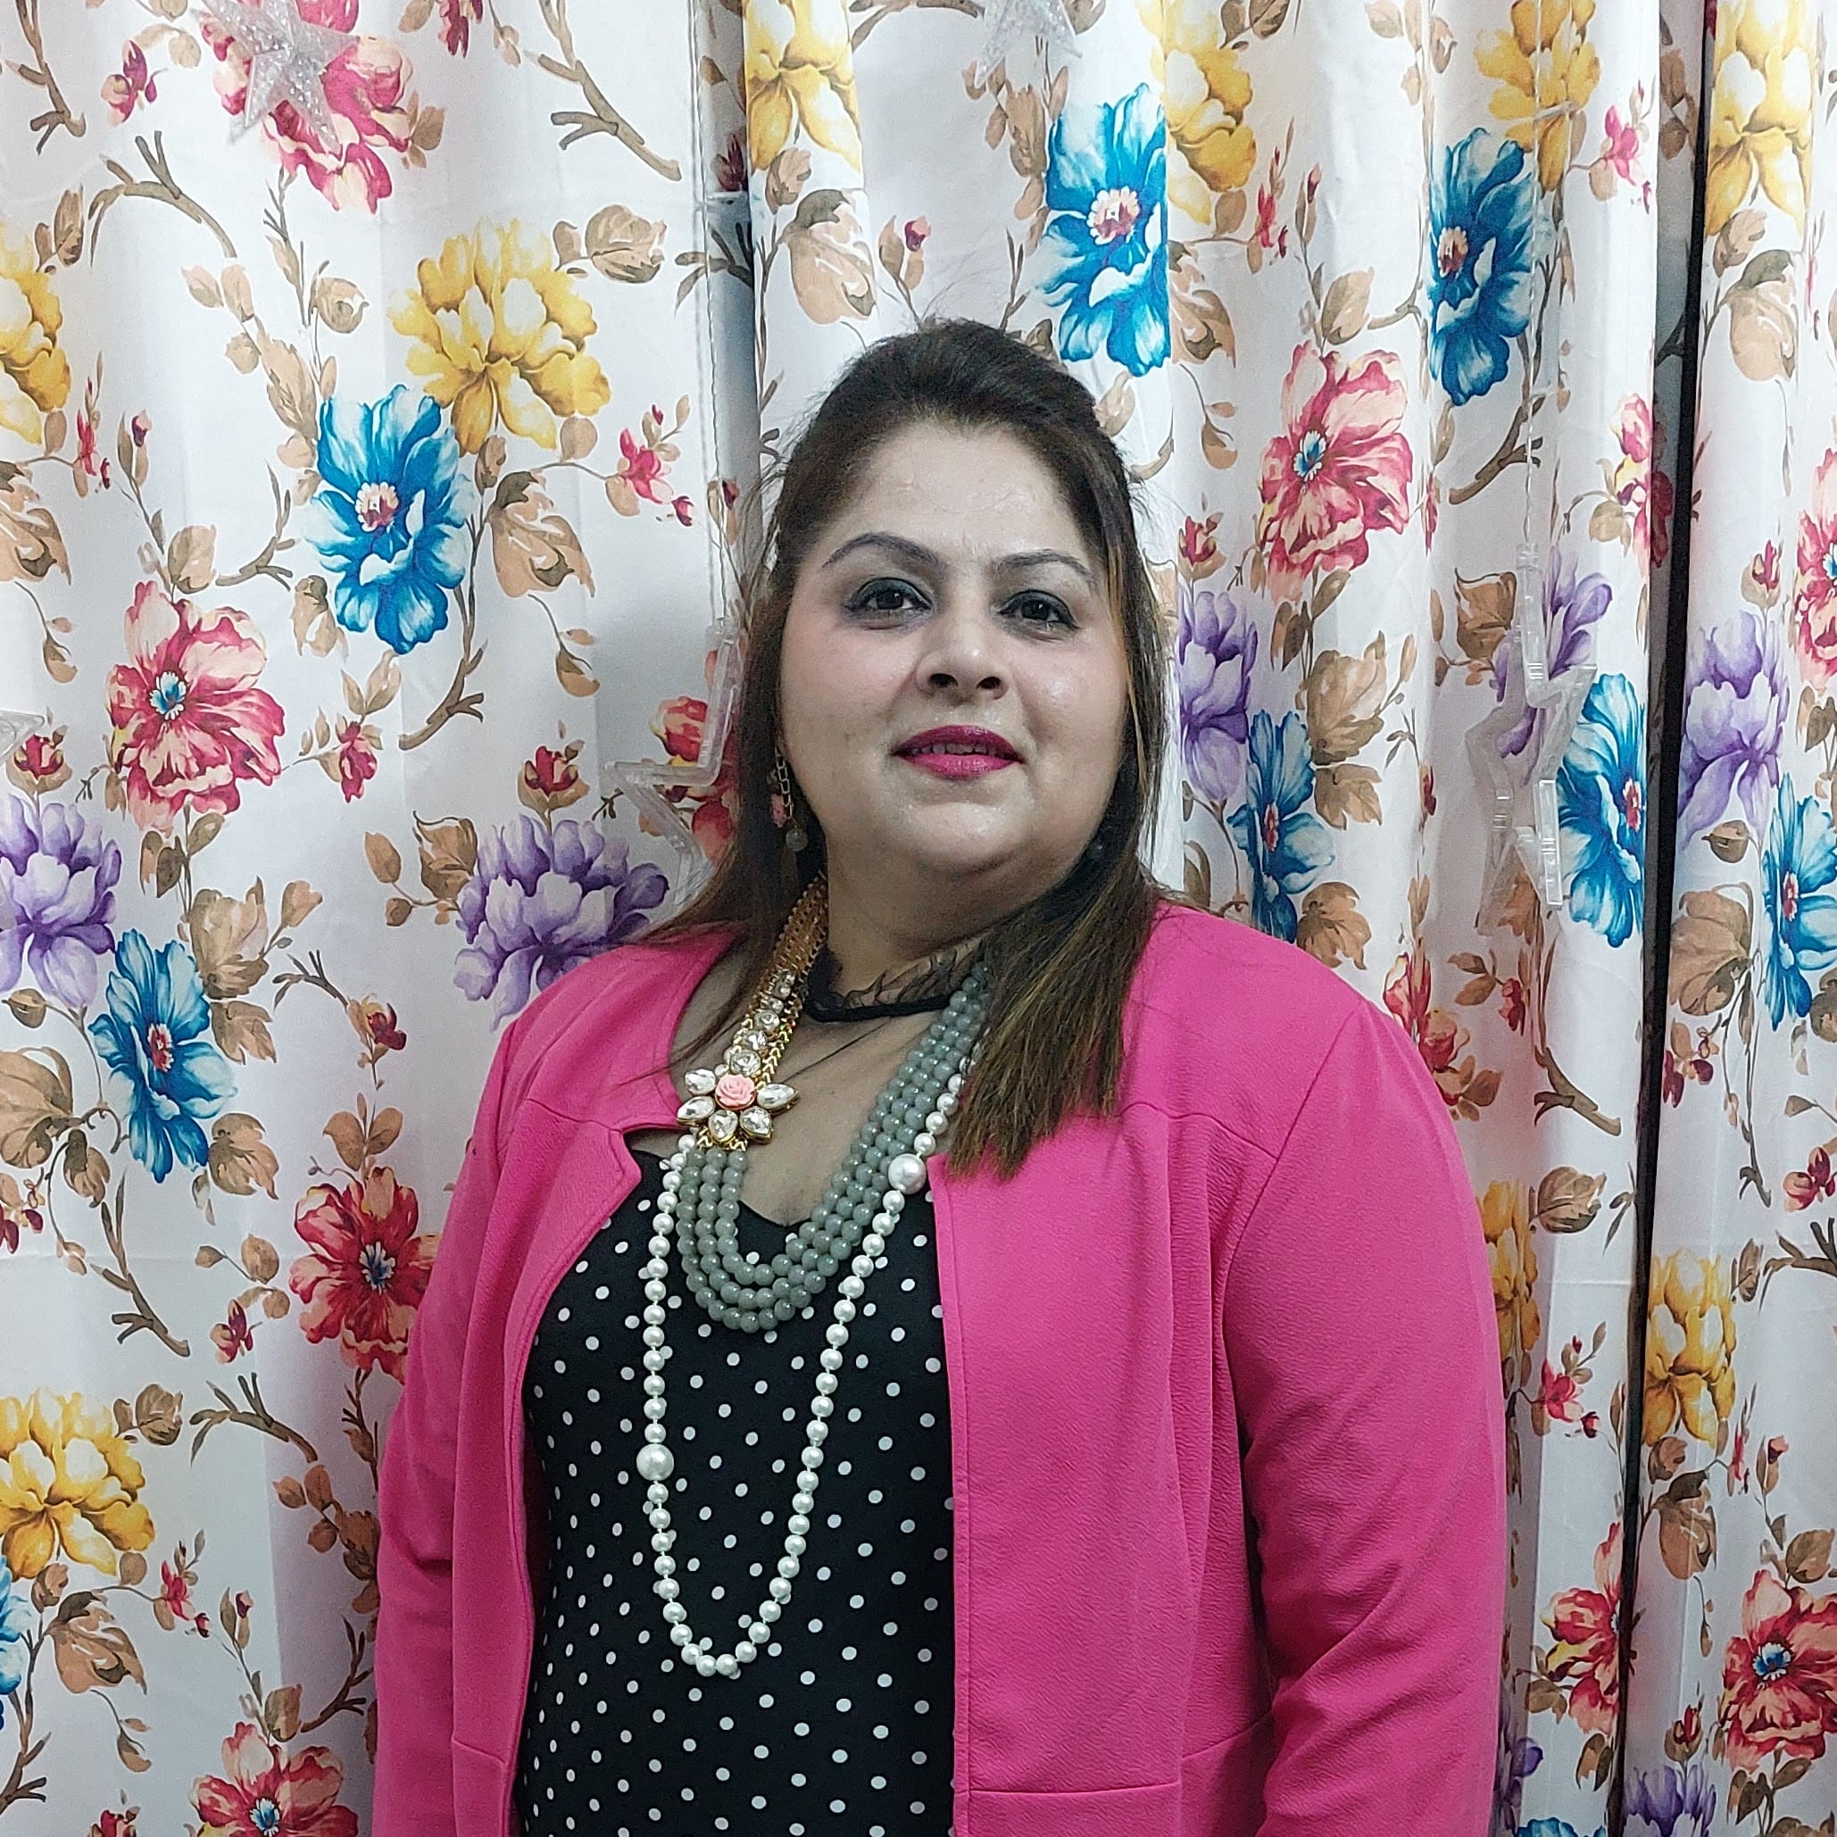
TYPE NAME & WICCI DESIGNATION
NAVNEET GREWAL (PRESIDENT), CONTENT WRITING & COMMUNICATION COUNCIL WICCI
BIO :-
Navneet Grewal is a psychology graduate and a qualified language teacher. Tasked as an editor and having written in various school magazines as well as station journals, writing has been an essential part of her sojourn. A part of five international poetry platforms has honed her affair with the pen. A published author her first poetry book ‘Our Hearts We Pen’ has been co - authored with her teenage daughter who is a writer too. She also is a part of nine international anthologies with reputed publishers.
Insert High Resolution Picture

Slide 5
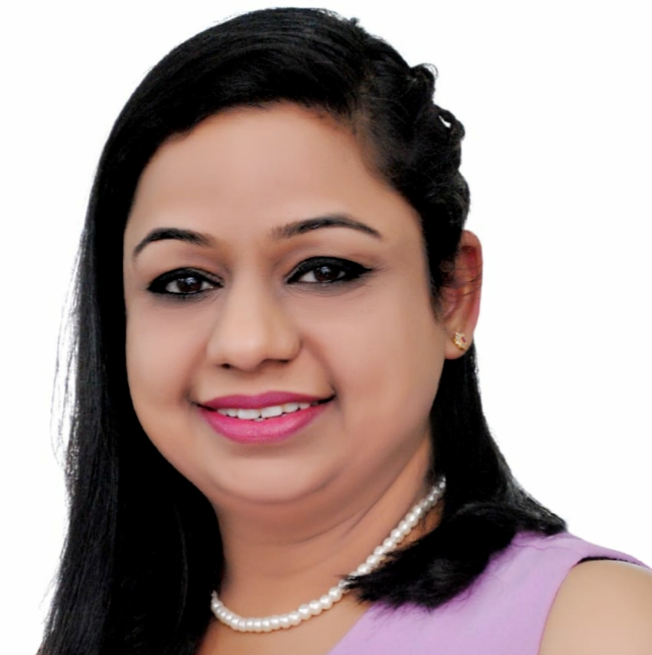
TYPE NAME & WICCI DESIGNATION
KAVITA GUPTA (VICE PRESIDENT), CONTENT WRITING & COMMUNICATION COUNCIL WICCI
BIO :-
I am a passionate Montessori educator with multicultural
experiences in nurturing the whole child – physically,
socially, emotionally, and intellectually. Currently, I am
running my own Kids studio where I focus on alternative &
progressive approaches to education. My aim is to create
an environment with material and activities that meet my
students unique interest and developmental needs. I
work on identifying that each child is different and so are
their needs and approach to work. My work involves
astute observation and child engagement skills.
Insert High Resolution Picture

Slide 6
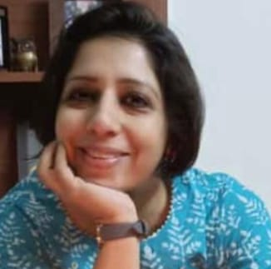
TYPE NAME & WICCI DESIGNATION
MILI CHOUDHARY (COUNCIL MEMBER), CONTENT WRITING & COMMUNICATION COUNCIL WICCI
BIO :-
She is a self taught artist who began her journey of
converting her passion to instructing art in 2017. She has
conducted workshops for women and children in
rehabilitation centers and various educational
institutions. She takes regular online art classes for kids.
Having delved in various mediums like acrylics, oil pastels
charcoal and soft pastels, she likes to fill the canvas with
vibrant hues of nature, expressive portraits and the
seamless calmness of still lives.
Insert High Resolution Picture

Slide 7
TYPE NAME & WICCI DESIGNATION
GUNJAN JAIN (COUNCIL MEMBER), CONTENT WRITING & COMMUNICATION COUNCIL WICCI
BIO :-
I have always been an energetic person & open to learning
new skills. I love collaborating with like minded people.
From taking new innovative to playing as a contributing
team member, I have always desired to work for the
betterment of society. During my schooling, I took part in
various competitions like Declamation contests, Painting,
Dancing, stage programs & art & craft. I also won many
prizes in the above contests. I am also learning &
practicing Yoga. I feel that WICCI would help me to follow
my passion of serving humanity & touching human lives.
Insert High Resolution Picture

Slide 8
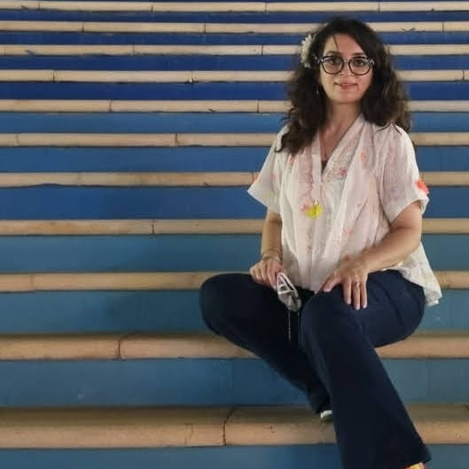
TYPE NAME & WICCI DESIGNATION
MUGDHA ARORA (COUNCIL MEMBER), CONTENT WRITING & COMMUNICATION COUNCIL WICCI
BIO :-
Mugdha Arora, a lawyer by training, artist at heart and
yogi by soul. She has almost 2 decades of experience
working in the legal field in India and Canada.
She founded *Mugdha's Initiative* with a bunch of
children to inculcate social responsibility among the
younger masses through theatre and lingual training. She
is managing partner of an Immigration Law Firm ( *Visa Law* ) with offices in India and UAE.
Insert High Resolution Picture

Slide 9
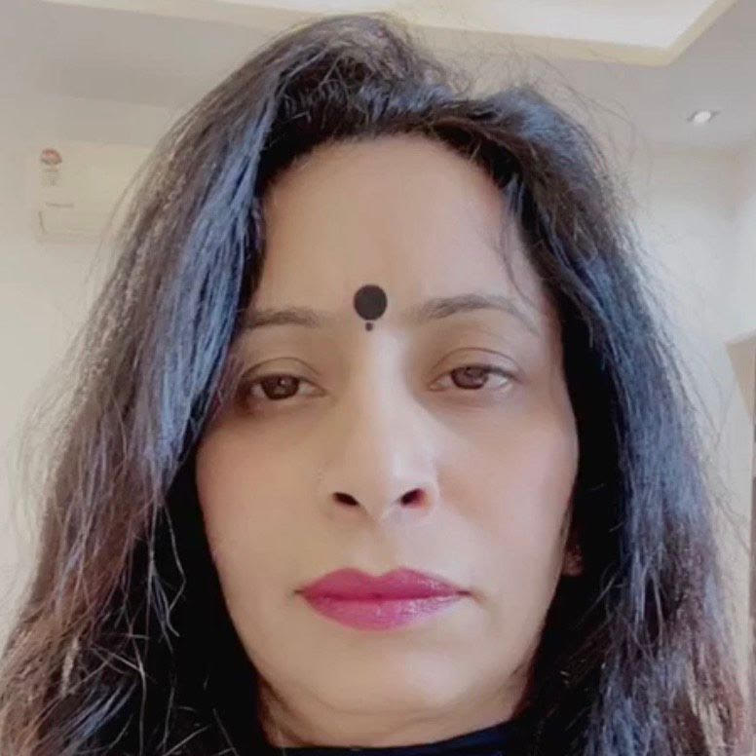
TYPE NAME & WICCI DESIGNATION
RENUKA CHUGH MIDDHA (COUNCIL MEMBER), CONTENT WRITING & COMMUNICATION COUNCIL WICCI
BIO :-
She is a fashion designer and post graduate in Hindi who
has published a wide number of books. She delves into
pottery art and is keen on yoga practice & aerobics. She
has received many awards in online seminars organized
by Kavya Manjari. Also awarded the 'Soul Yogi' by Divine
soul yoga.
Insert High Resolution Picture

Slide 10
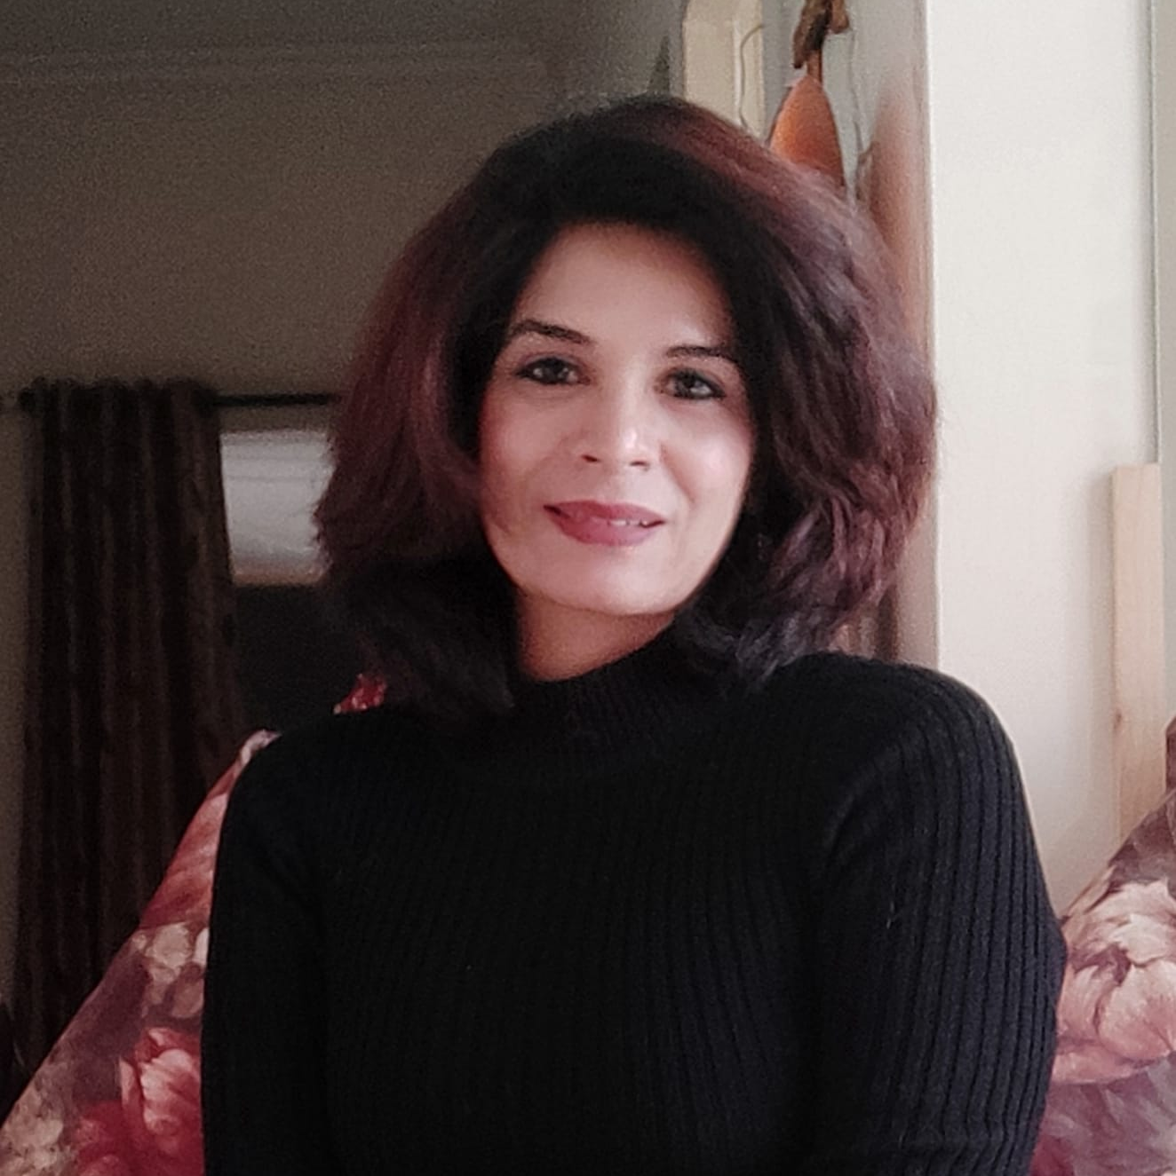
TYPE NAME & WICCI DESIGNATION
VANDANA BALHARA (COUNCIL MEMBER), CONTENT WRITING & COMMUNICATION COUNCIL WICCI
BIO :-
With my passion for training in soft skills and an
educationist background, I have been able to transform
professionals and students, empowering them and
helping them become master of their lives through
interactive sessions bringing about a desirable shift in
their mindsets, making them adaptable to professional,
personal, and social life. With my self-driven attitude, I
always look for opportunities to learn, grow and upskill
keeping in view the dynamic professional and educational
environment.
Insert High Resolution Picture

Slide 11
TYPE NAME & WICCI DESIGNATION
SUGANDHA WALIA (COUNCIL MEMBER), CONTENT WRITING & COMMUNICATION COUNCIL WICCI
BIO :-
Homebaker trying to feed the world and gaining quite a few calories in the process!
Insert High Resolution Picture

Slide 12
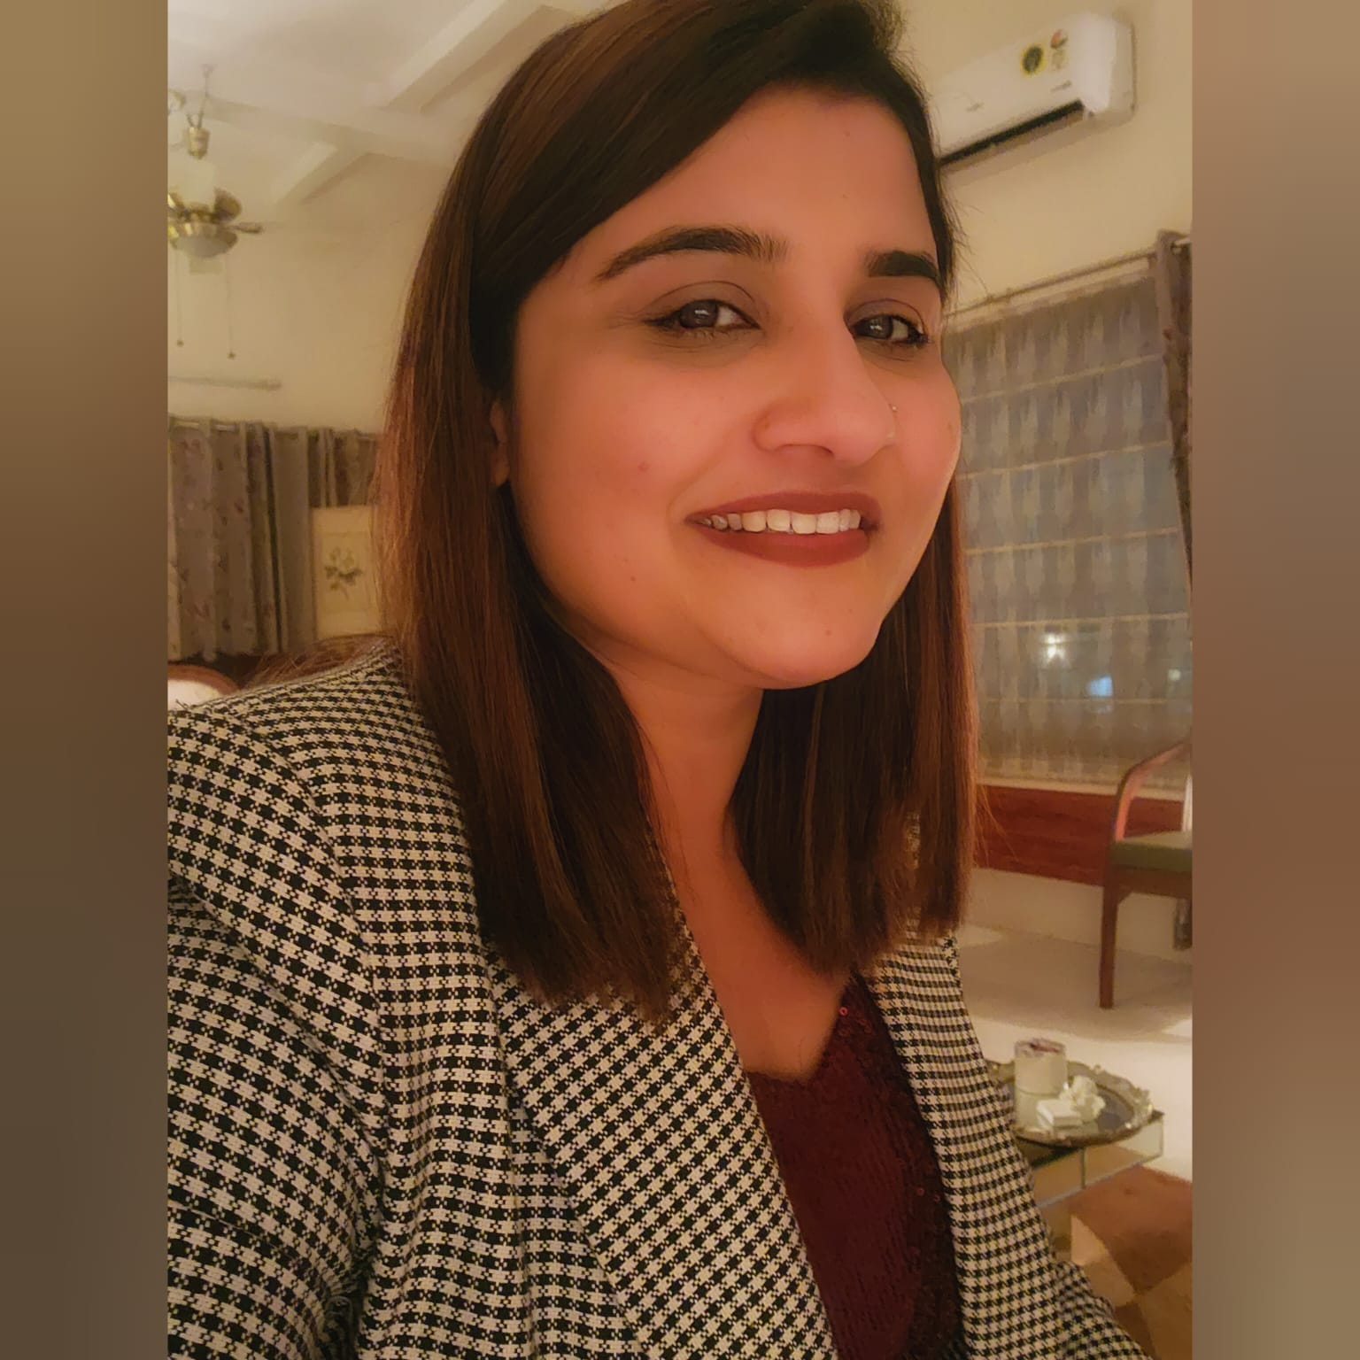
TYPE NAME & WICCI DESIGNATION
NAVJOT NAIN (COUNCIL MEMBER), CONTENT WRITING & COMMUNICATION COUNCIL WICCI
BIO :-
The curator and the mind behind the "Olive Loft" - a
platform where she showcases and sells high end home decor products and linen. With a penchant for interior decoration and a love for making origami and paper crafts.
Insert High Resolution Picture

Slide 13
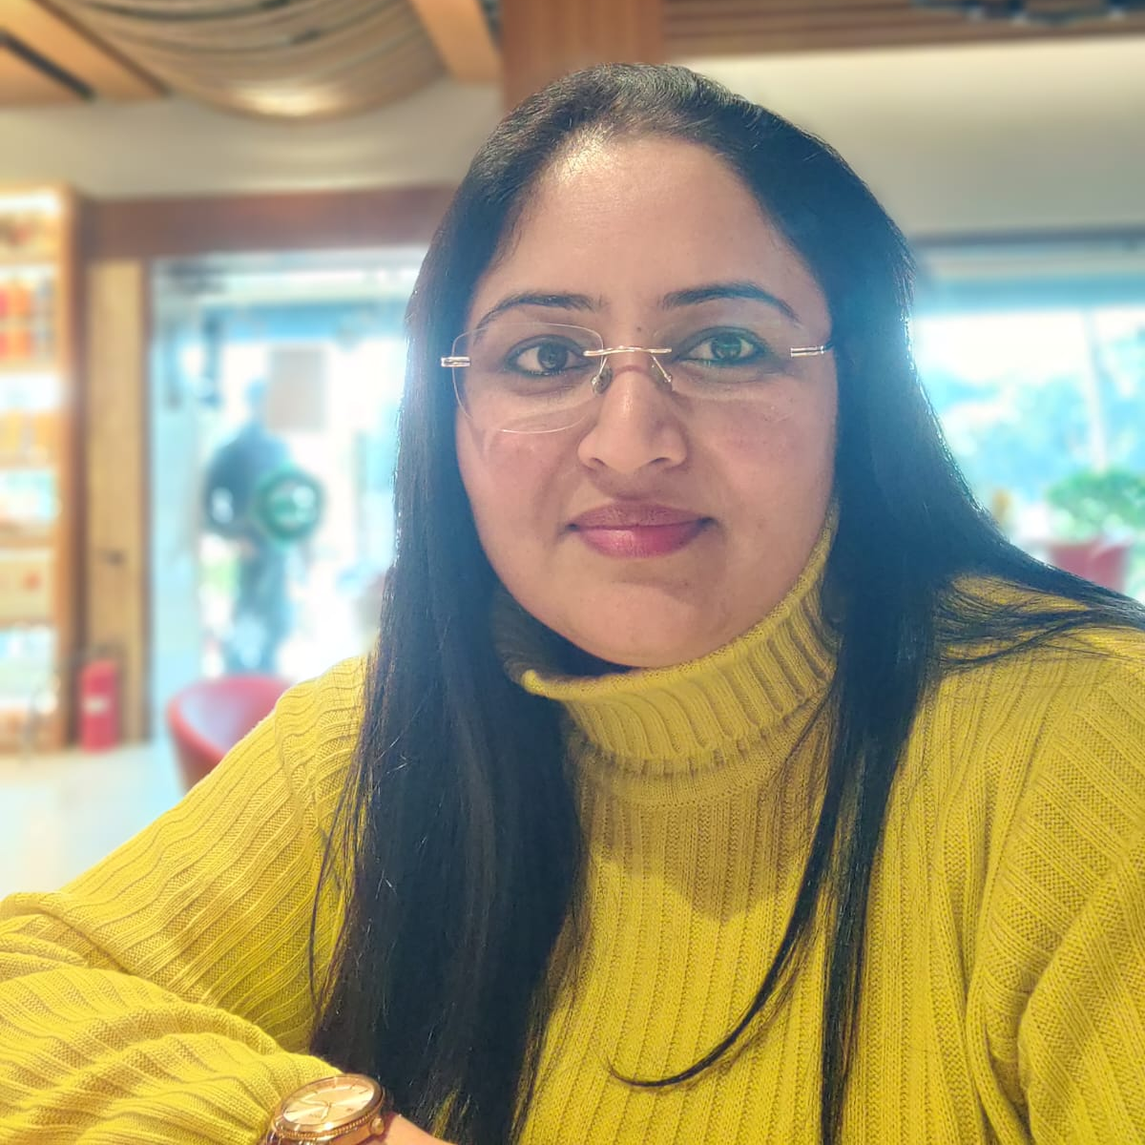
TYPE NAME & WICCI DESIGNATION
KANWALDEEP KAUR (COUNCIL MEMBER), CONTENT WRITING & COMMUNICATION COUNCIL WICCI
BIO :-
She is the owner of "Bandhura Creations" - a floral
venture which is dedicated to the 'hand-painted floral art
lovers'. It is an expression of ideas, concept and feelings
which when combined together takes the shape of
beautiful and exclusive art pieces with the help of silk
paints, silk dyes, brushes and imagination. With it's
exclusively conceptualized designs, choice of the colour
tones and hues, imported silk paints and silk dyes which
give a completely different sheen and shine to your
wearables!
Insert High Resolution Picture

Slide 14
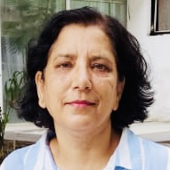
TYPE NAME & WICCI DESIGNATION
ANITA SHARMA (COUNCIL MEMBER), CONTENT WRITING & COMMUNICATION COUNCIL WICCI
BIO :-
Anita Sharma hails from a family steeped in military
tradition for four generations. She has roots in Himachal
Pradesh and currently resides in Noida. An educator by
profession, she is passionate about teaching and
travelling. She has published two books;
Home Run (literary fiction)
A Handful of Dewdrops (collection of poems) in 2021
Insert High Resolution Picture

Slide 15
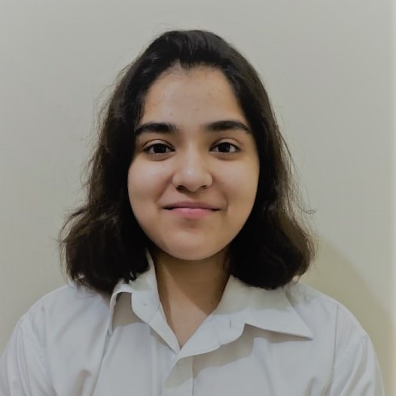
TYPE NAME & WICCI DESIGNATION
HARNOOR GREWAL (COUNCIL MEMBER), CONTENT WRITING & COMMUNICATION COUNCIL WICCI
BIO :-
Harnoor Grewal is a teenager who is a published writer, poet and passionate photographer running on an overwhelming urge to capture the essence of moments and add meaning to it by her words. She believes that to create art is to be devoid from the uncertainties of the world, and live a life as magical as in the fairy tales. She also wishes to bring positive changes through her writing by uniting articles ranging from the political world to the density of law reforms and its effects on the common man. She is an optimist and strongly believes in the power of words.
Insert High Resolution Picture

Slide 16
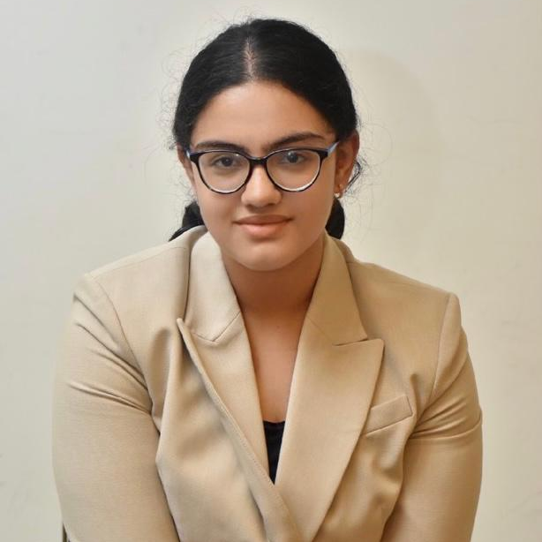
TYPE NAME & WICCI DESIGNATION
NAVNOOR RANA (COUNCIL MEMBER), CONTENT WRITING & COMMUNICATION COUNCIL WICCI
BIO :-
A keen writer and a prolific shooter Navnoor has written various poems and articles. A master of words carving her sojourn beautifully with syllables from the heart.
Insert High Resolution Picture

Slide 17
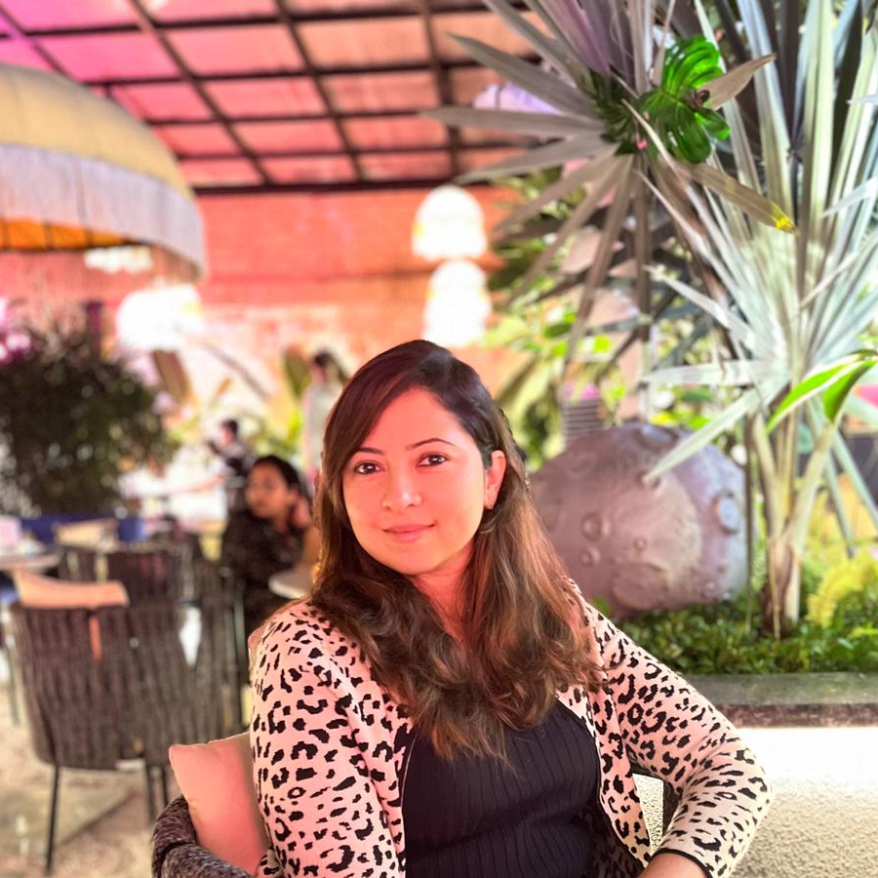
TYPE NAME & WICCI DESIGNATION
RASHMI SIDHU (COUNCIL MEMBER), CONTENT WRITING & COMMUNICATION COUNCIL WICCI
BIO :-
A content creator who has worked on many projects on a freelance basis.
Insert High Resolution Picture

Slide 18
TYPE NAME & WICCI DESIGNATION
SAMRITI DESWAL (COUNCIL MEMBER), CONTENT WRITING & COMMUNICATION COUNCIL WICCI
BIO :-
Samriti is an assistant professor and a co-ordinator in the Applied Sciences (Physics Group) .With an excellent communication skill she has conducted many workshops and framed assessment reports for her students.
Insert High Resolution Picture

Slide 19
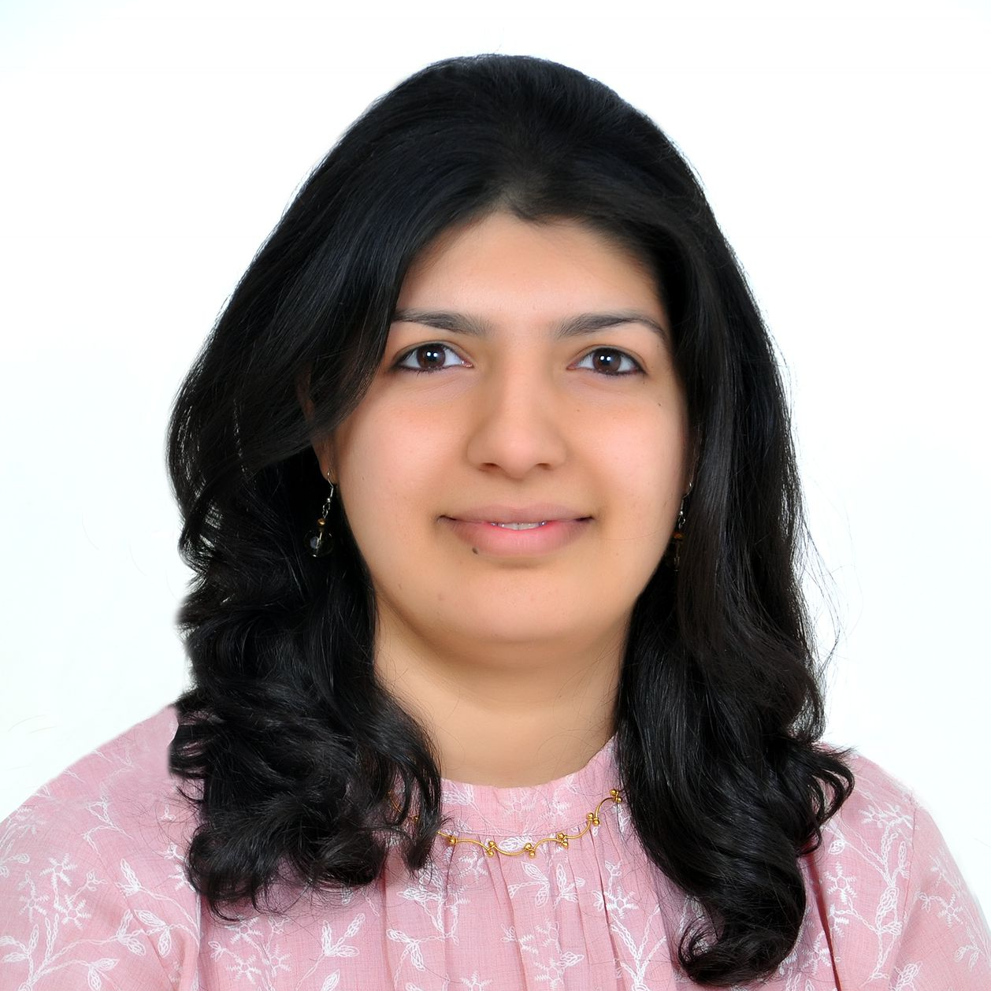
TYPE NAME & WICCI DESIGNATION
VINODINI SAIHJPAL (COUNCIL MEMBER), CONTENT WRTING & COMMUNICATION COUNCIL WICCI
BIO :-
Vinodini draws experience from both industry and
academia. She has been teaching as guest faculty at Punjab University and NIIFT Mohali. Currently she is working in the Indian School of Business (ISB).
Insert High Resolution Picture

Slide 20
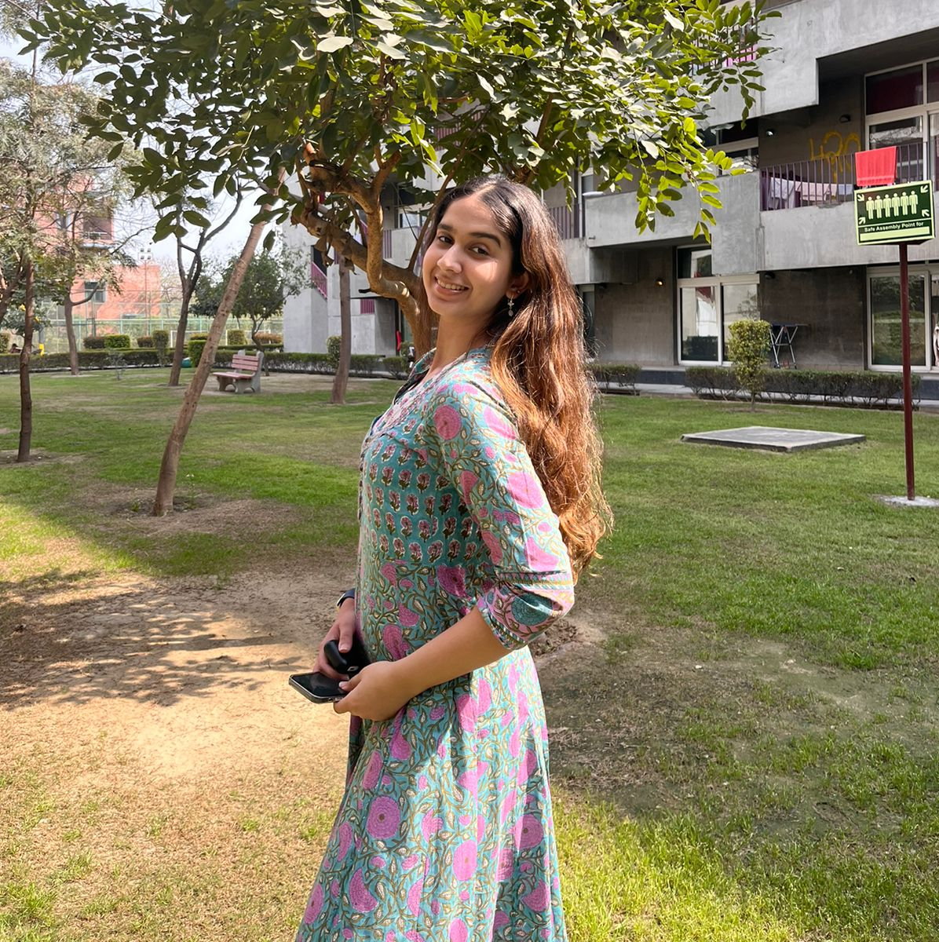
TYPE NAME & WICCI DESIGNATION
HUNNAR NANGRU (COUNCIL MEMBER), CONTENT WRITING & COMMUNICATION COUNCIL WICCI
BIO :-
A budding writer and a psychology Honours graduate, Hunnar likes to weave words in her experiences.
Insert High Resolution Picture

Slide 21
SUPPORTED BY
WICCI is supported by the massive global networks of ALL Ladies League (ALL), Women Economic Forum (WEF), and SHEconomy.
ALL is a movement of ‘Sisters Beyond Borders.’
WEF is a platform for ‘Business Beyond Borders.’ SHEconomy is e-commerce for women worldwide in Goods & Services for ‘Commerce Beyond Borders’

Slide 22
COUNTRIES REPRESENTED
Albania, Angola, Armenia, Argentina, Australia, Azerbaijan, Bangladesh, Brazil, Burundi, Cameroon, Canada, Chad, China, Costa Rica, Croatia, Cyprus, Czech Republic, Colombia, Ecuador, Egypt, Ghana, Germany, Greece, Guatemala, Hong Kong, Hungary, India, Italy, Israel, Ireland, Japan, Kazakhstan, Kenya, Kyrgyzstan, Lesotho, Luxembourg, Malawi, Malaysia, Mexico, Moldova, Monaco, Montenegro, Morocco, Mozambique, Malta, Netherlands, Nigeria, Nepal, New Zealand, North Macedonia, Norway, Paraguay, Portugal, Peru, Puerto Rico, Philippines, Qatar, Romania, Russia, Rwanda, Serbia, Singapore, Slovenia, Spain, South Africa, South Korea, Suriname, Sweden, Switzerland, Syria, Tunisia, Turkey, Uganda, Ukraine, UK, Uruguay, Venezuela, Vietnam, Virgin Islands (US), UAE, USA, Uzbekistan, Zimbabwe.

Slide 23
WOMEN'S INDIAN CHAMBER OF COMMERCE ANDINDUSTRY

